Slide 1
IMPROVING DEMOLDING MANUFACTURING CONSTRAINTS FOR GRADIENT-BASED TOPOLOGY OPTIMIZATION WITHIN SIMULIA TOSCA STRUCTURE
Arvinth Shankar
Supervisors
Lisa-Marie Krauß
Thorsten Mertins, Peter Clausen

Slide 2
AGENDA
MOTIVATION
INTRODUCTION
PROPOSED CONCEPT
RESULTS
CONCLUSION AND FUTURE STEPS

Slide 3
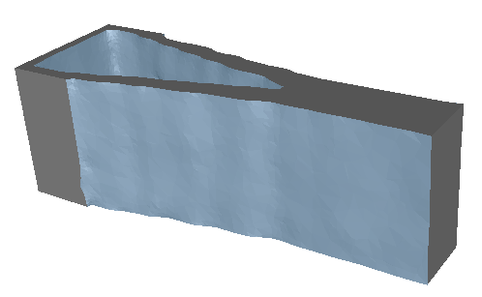
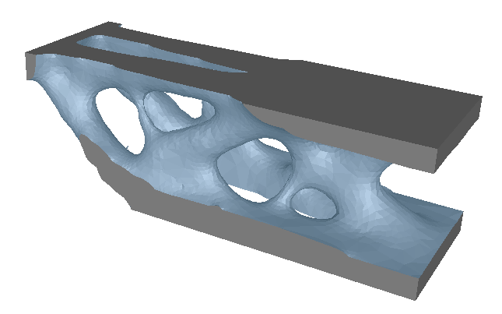
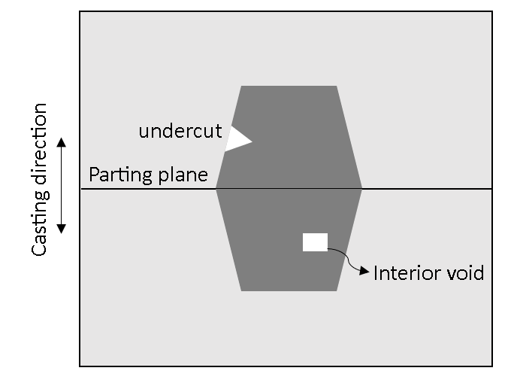
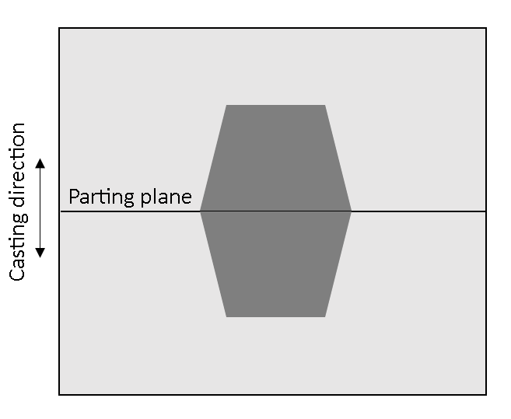
MOTIVATION
Topology optimization sometimes result in structures that are not manufacturable, for example; by casting.
Cast restrictions are then applied to the optimization
Few methods are available to enforce cast restrictions. One such method is by parametrizing the design domain.
Aim - to modify and improve the parametrization in the current Tosca Structure inorder to obtain a clear and consistent castable result.
Casting
direction
With casting restriction
Interior cavities make the model not demoldable
No casting restriction
Not castable
Castable

Slide 4
INTRODUCTION

Slide 5
INTRODUCTION
Parameters are defined in a way to enforce casting constraint
Element relative densities (ρ)
Parameters (P)
Optimizer
δΦ
δρ
δΦ
δP
Element sensitivities
Parameter sensitivities
dΦ
dP
δΦ
δρ
dρ
dP
=
Φ – design response
Optimized parameters (P)
ρ = F(P) [mapping]
Relative densities (ρ)

Slide 6
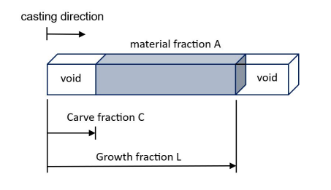
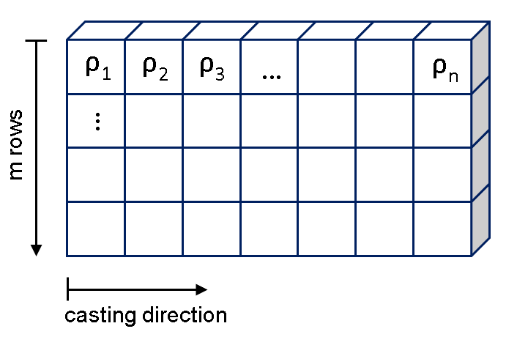
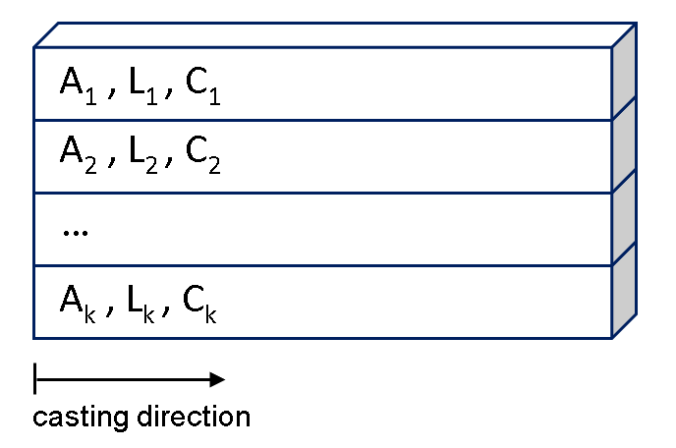
INTRODUCTION
OVERVIEW ON PARAMETERS
(Leiva et al., 2013)
A_{pol} - Pole area density
L_{pol} - Growth fraction for poles
C_{pol} - Carve fraction for poles
Relative densities of each element ρ_{i}
Finite elements
Poles

Slide 7
PROPOSED CONCEPT

Slide 8
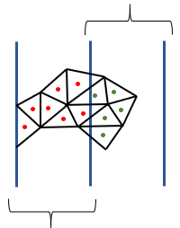
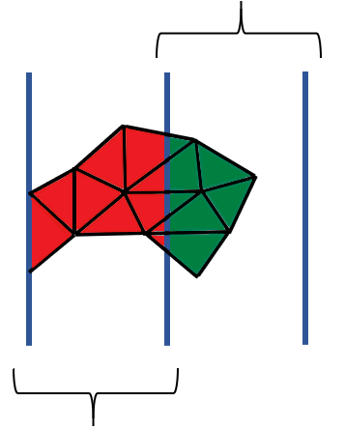
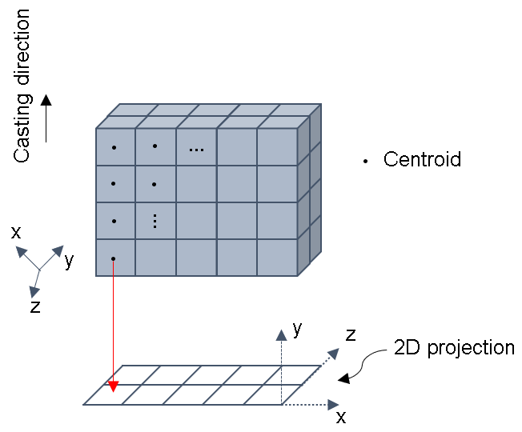
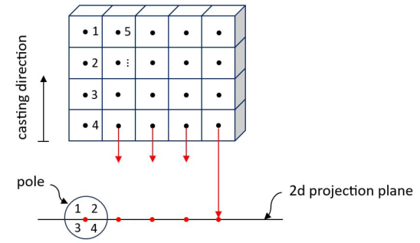
PROPOSED CONCEPT
CURRENT TOSCA, CUBOID CENTROIDS AND VOLUME FRACTION
pole 2
pole 2
belongs to pole 1
belongs to pole 2
Volume fraction (V_{f})
pole 1
pole 1
Current Tosca
Cuboid centroids
Mapping
Sensitivities
ρ = F(P)
dΦ
dP
δΦ
δρ
dρ
dP
=
V_{f} taken into account
V_{f} taken into account

Slide 9
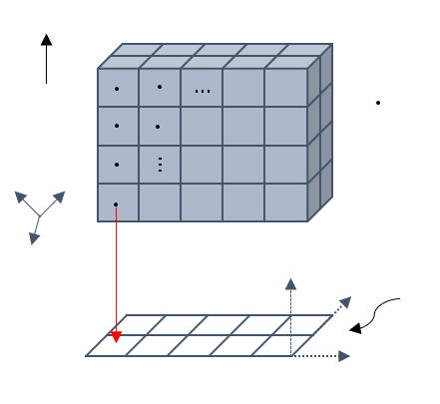
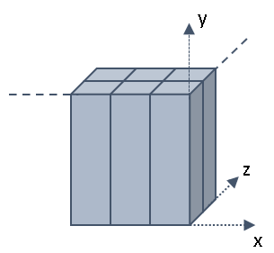
PROPOSED CONCEPT
OVERVIEW ON FORMATION OF CUBOID POLES
1
Rotation of coordinate axis to point along cast direction
casting direction
Projection of element centroids (rotated coordinate value) to each grid/pole
2
centroids
3
Sorting of element centroids in each pole along the cast direction
x
y
y
z
y
z
2D projection plane
z
x
x
3d view

Slide 10
PROPOSED CONCEPT
MAPPING BASED ON VOLUME FRACTIONS
ρ = F(P)
→
ρ_{e} = ƒ₁(A_{pol}) x ƒ₂(L_{pol}) x ƒ₃(C_{pol})
1
ƒ₁(A_{pol}) = V_{f} A_{pol}, V_{f} - volume fraction of an element inside a pole
pole 2
Element i
ƒ₁(A_{pol}) = V_{f, pole1} A_{pole1} + V_{f, pole2} A_{pole2}
i
2
ƒ₂(L_{pol}) = Φ(H^{e}(L_{pol}))
3
ƒ₃(C_{pol}) = Φ(B^{e}(C_{pol}))
1
1
pole 1
ƒ₂(L_{pol})
ƒ₃(C_{pol})
0
0
h^{e}_{min}
h^{e}_{max}
H^{e}(L_{pol})
h^{e}_{min}
h^{e}_{max}
B^{e}(C_{pol})

Slide 11
PROPOSED CONCEPT
SENSITIVITY MAPPING
dΦ
dP
δΦ
δρ
dρ
dP
δΦ
δρ
dF(P)
dP
=
=
dƒ₂(L_{pol})
dL_{pol}
dΦ
dA_{pol}
δΦ
δρ_{e}
dF(A_{pol}, L_{pol}, C_{pol})
dA_{pol}
δΦ
δρ_{e}
dƒ₁(A_{pol})
dA_{pol}
1
=
=
. ƒ₂(L_{pol}) . ƒ₃(C_{pol})
0
h^{e}_{min}
h^{e}_{max}
H^{e}(L_{pol})
V_{f}
dΦ
dL_{pol}
δΦ
δρ_{e}
dF(A_{pol}, L_{pol}, C_{pol})
dL_{pol}
δΦ
δρ_{e}
dƒ₂(L_{pol})
dL_{pol}
2
=
=
. ƒ₁(A_{pol}) . ƒ₃(C_{pol})
dƒ₃(C_{pol})
dC_{pol}
V_{f} . A_{pole}
dΦ
dC_{pol}
δΦ
δρ_{e}
dF(A_{pol}, L_{pol}, C_{pol})
dC_{pol}
δΦ
δρ_{e}
dƒ₃(C_{pol})
dC_{pol}
3
=
=
. ƒ₁(A_{pol}) . ƒ₂(L_{pol})
0
h^{e}_{min}
h^{e}_{max}
B^{e}(C_{pol})
V_{f} . A_{pole}

Slide 12
RESULTS

Slide 13
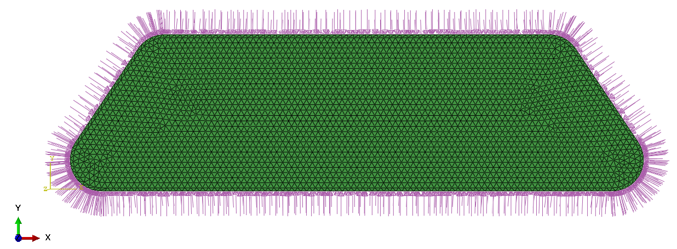
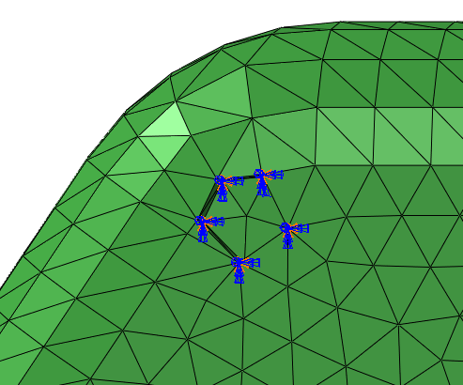
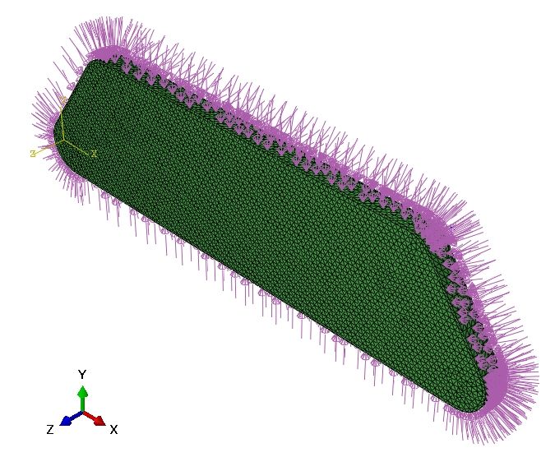
RESULTS
OIL PAN MODEL (≈100K elements)
Cast direction
Optimization inputs
Objective : minimize compliance
Constraint : local volume ≤ 50%
Midplane : full design height
Frozen elements : Outer surface elements
Midplane - full design height
Boundary conditions
Load conditions
top
L_{min},L_{max}
= 1
bottom
C_{min},C_{max}
= 0

Slide 14
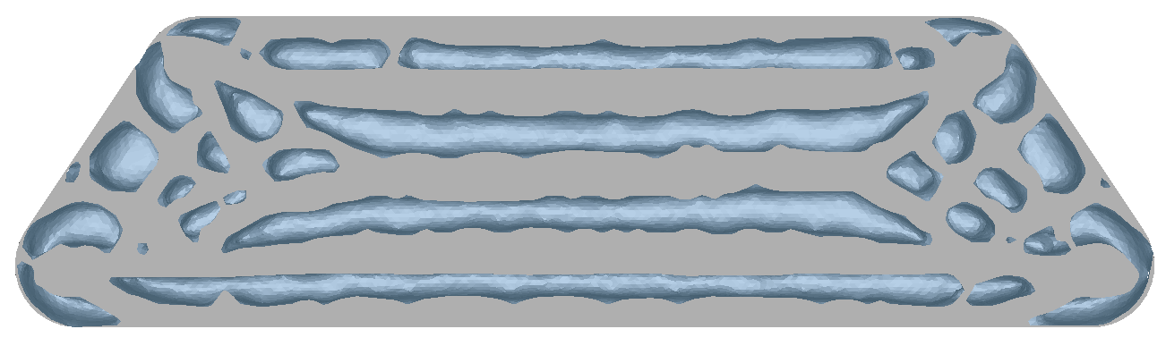
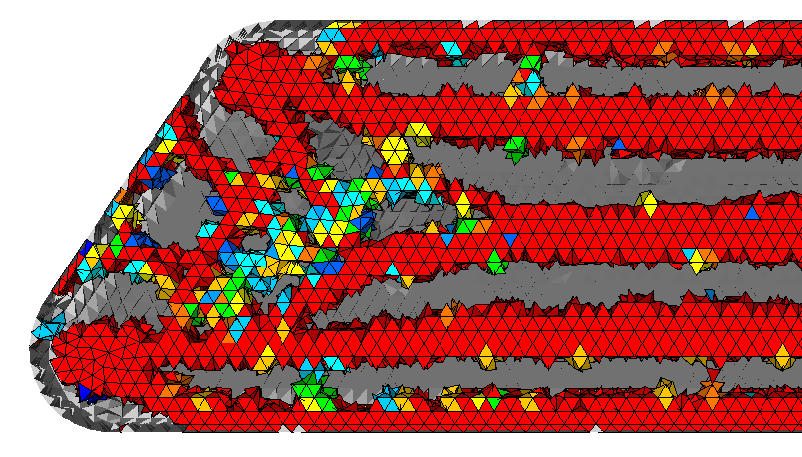
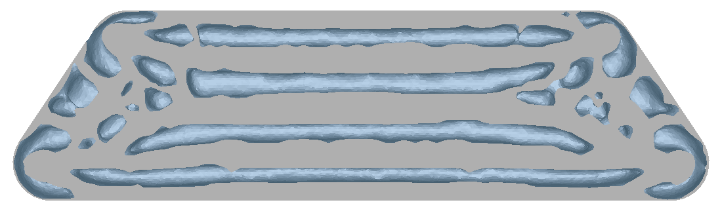
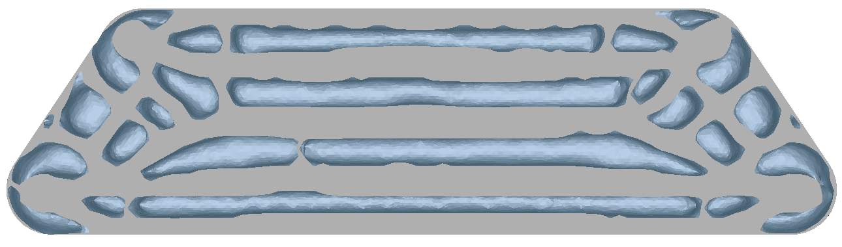
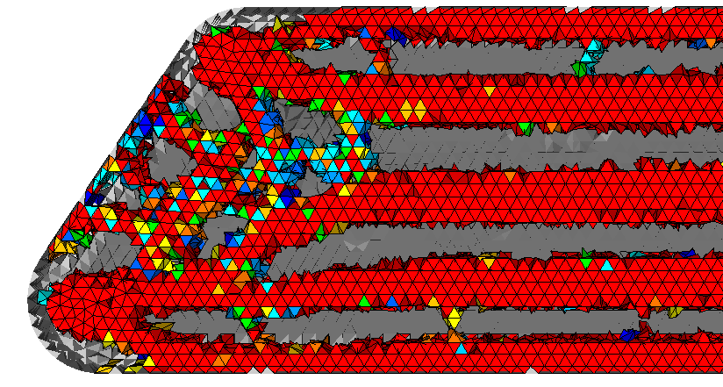
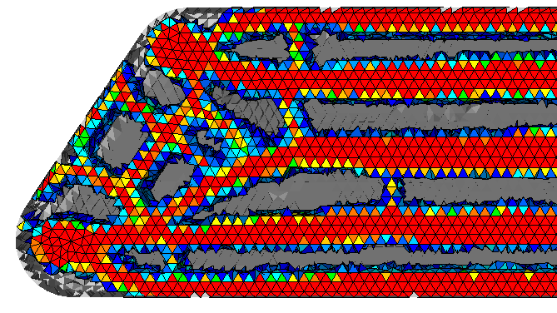
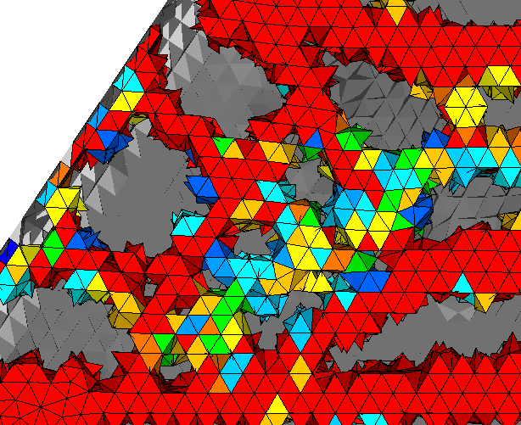
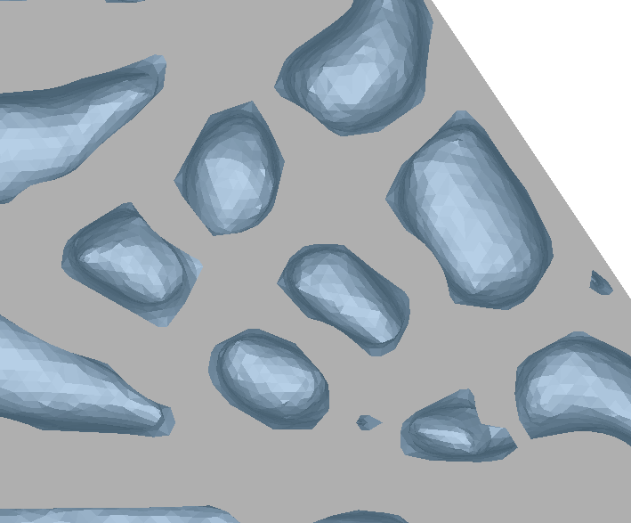
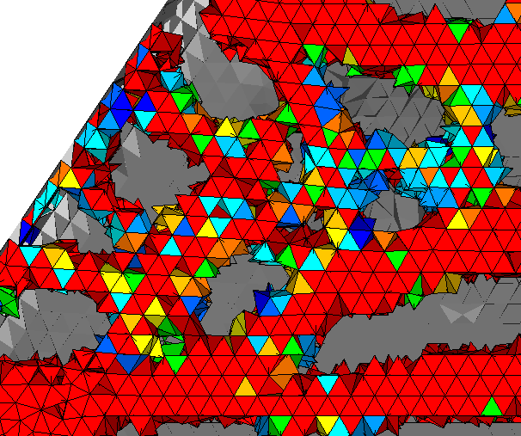
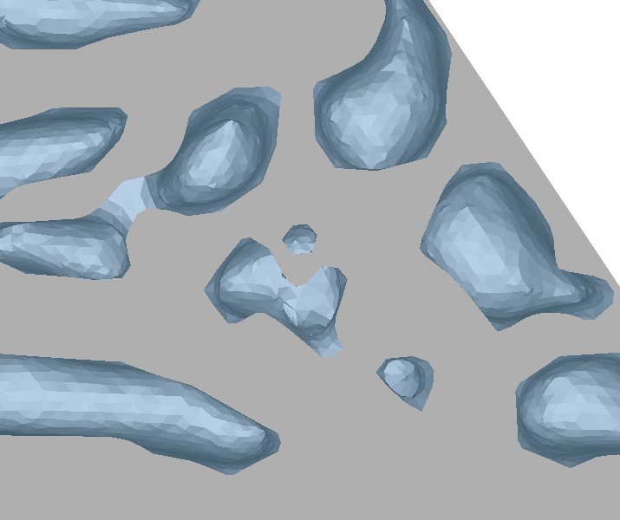
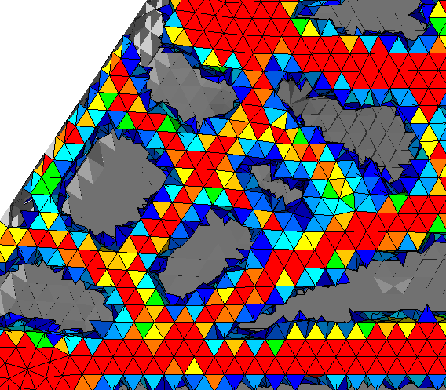
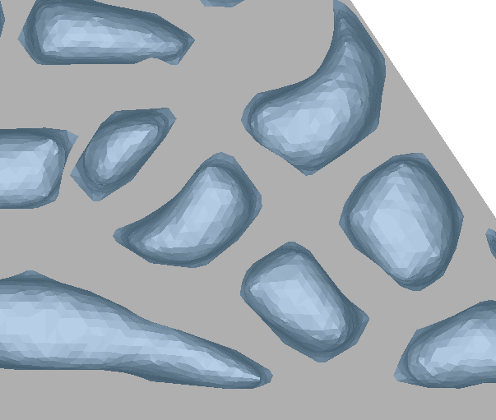
OIL PAN MODEL
Current Tosca
Cuboid centroids
Volume fraction
Obj value : 1.82 x 10⁻⁶
Obj value : 1.74 x 10⁻⁶
Obj value : 1.95 x 10⁻⁶
- 4%
+ 7%
reference

Slide 15
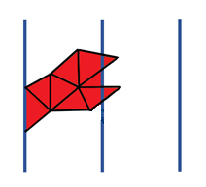
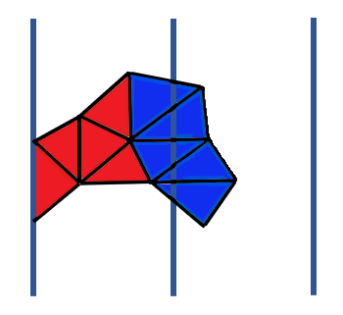
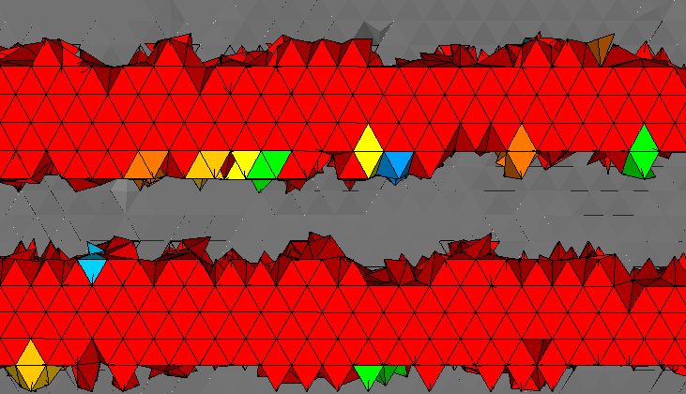
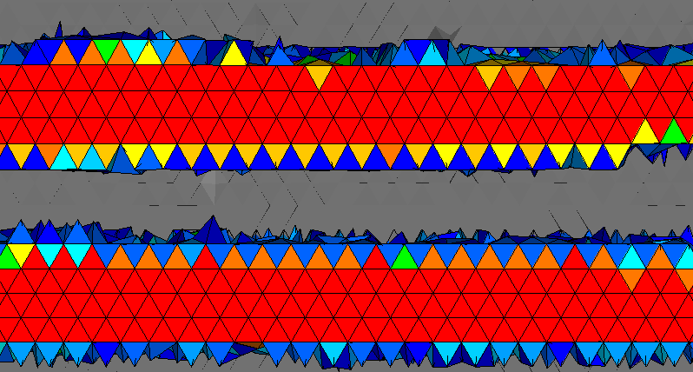
OIL PAN MODEL
QUALITATIVE COMPARISON OF RESULTS
ρ_{pole2} ≈ 0
ρ_{pole2} ≈ 0
ρ_{pole1} ≈ 1
ρ_{pole1} ≈ 1
Centroid based – both current Tosca and cuboid centroids
Volume fraction based

Slide 16
OIL PAN MODEL
PERFORMANCE COMPARISON FOR THREE METHODS (8 CPUs & 1 CPU)
Current Tosca
Cuboid centroids
Volume fraction with sparse storage
50k | 100k | 200k | 500k
50k | 100k | 200k | 500k
No. of elements
No. of elements

Slide 17
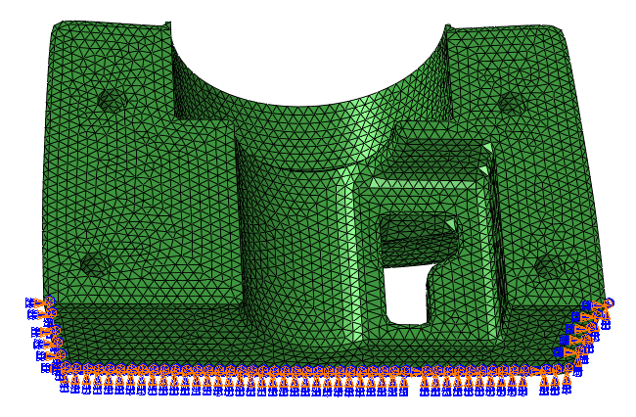
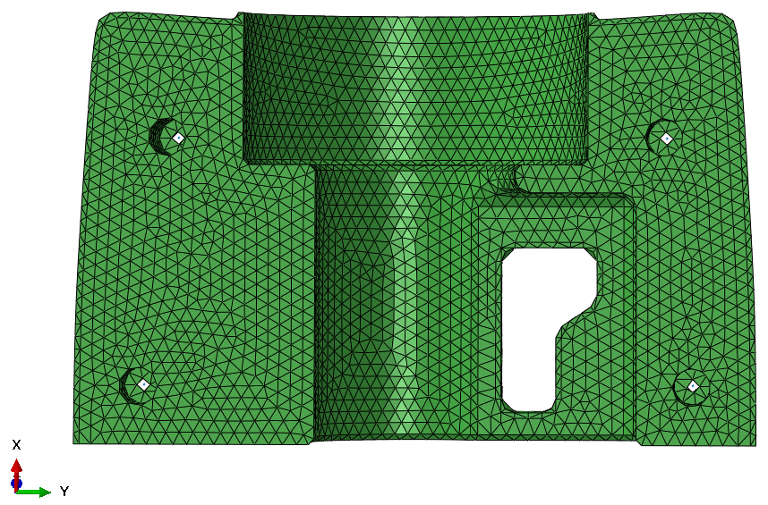
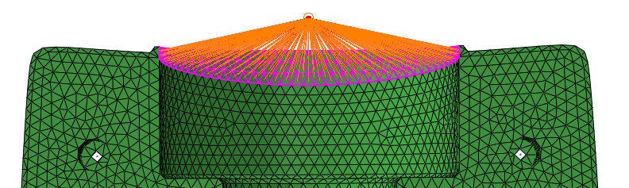
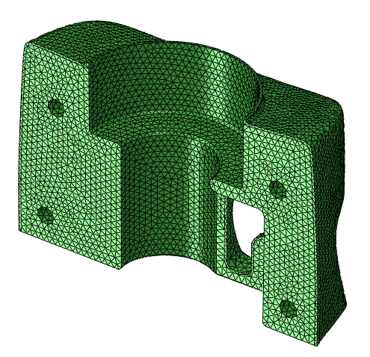
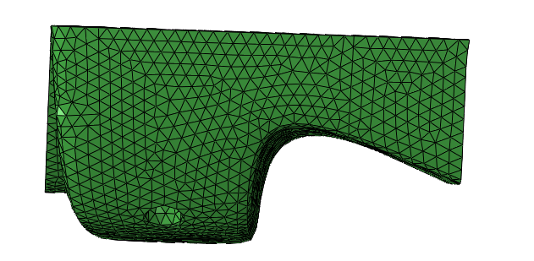
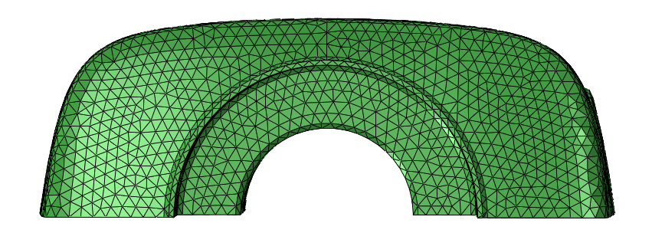
STEERING MODEL (≈130k elements)
FE model and optimization inputs
Cast direction
Optimization inputs
Objective : minimize compliance
Constraint : local volume and volume
Midplane : variable height
Frozen elements : Outer surface elements
Fixed B.C
Midplane – variable height
Coupling constraint
top
Side view
Top view
3d view
variable L_{max}
bottom
C_{min},C_{max},L_{min}
= 0

Slide 18
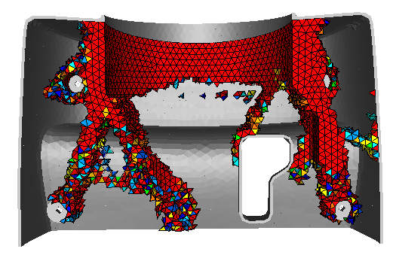
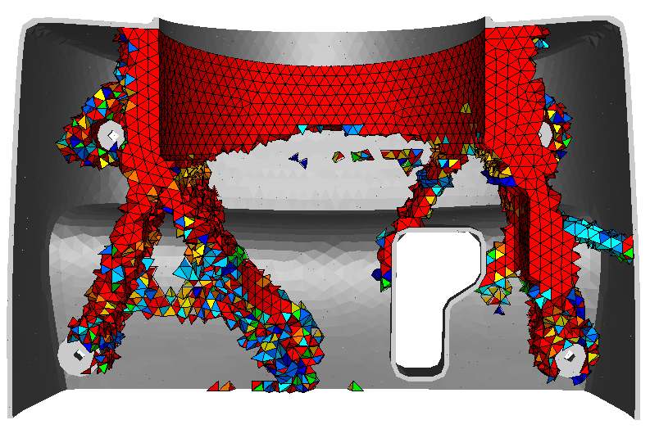
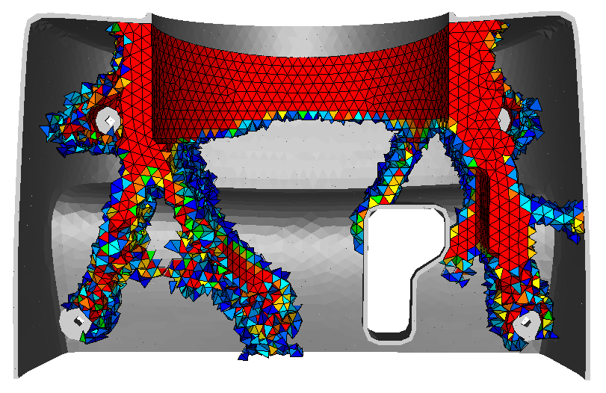
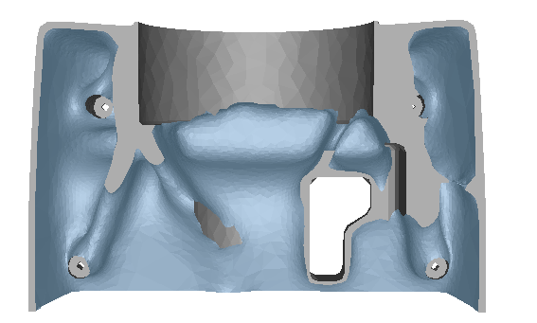
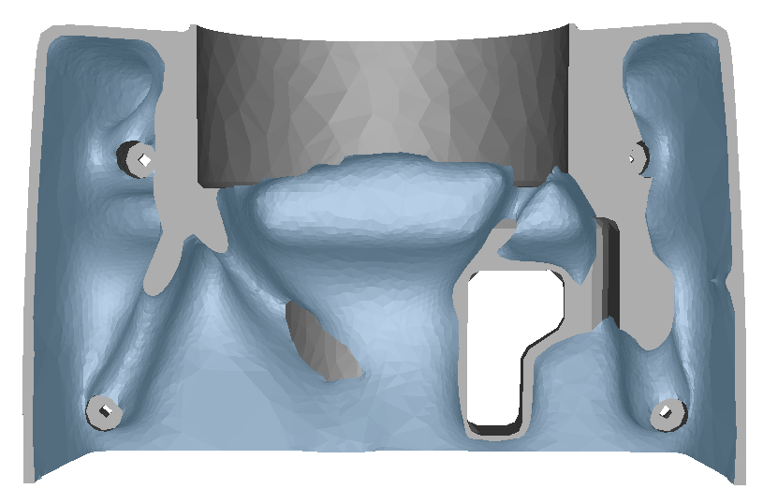
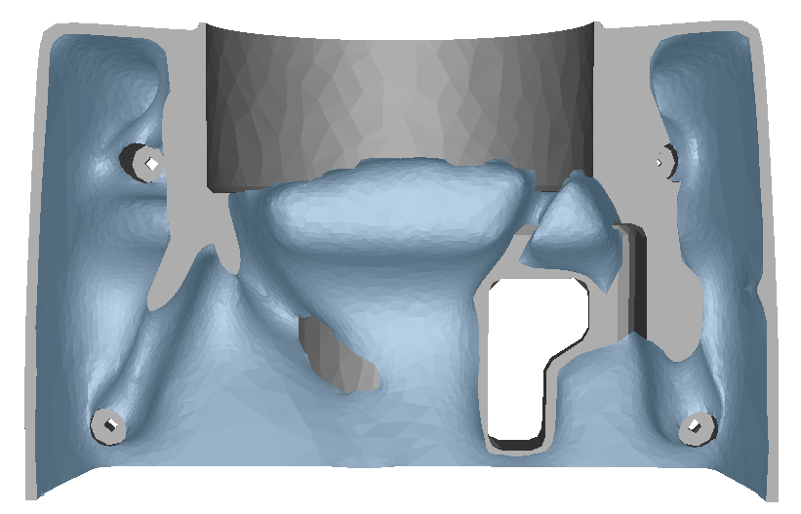
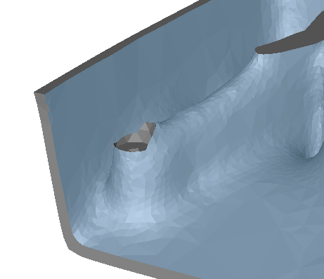
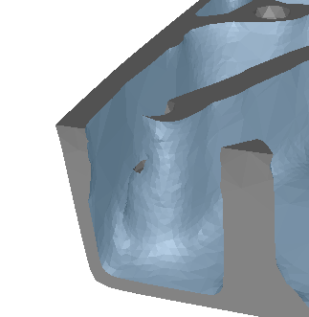
STEERING MODEL
Current Tosca
Cuboid centroids
Volume fraction
Optimization with local volume ≤ 70%
Midplane – variable height
Midplane – full design height
design height
Rib height
design height
Rib height

Slide 19
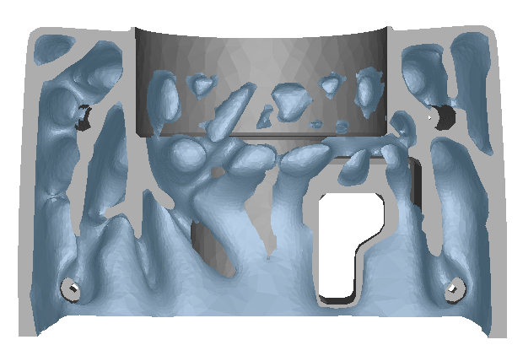
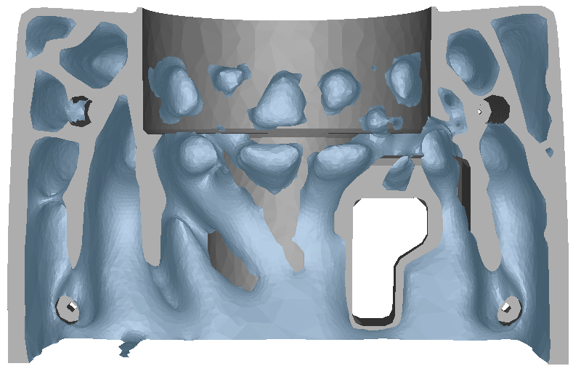
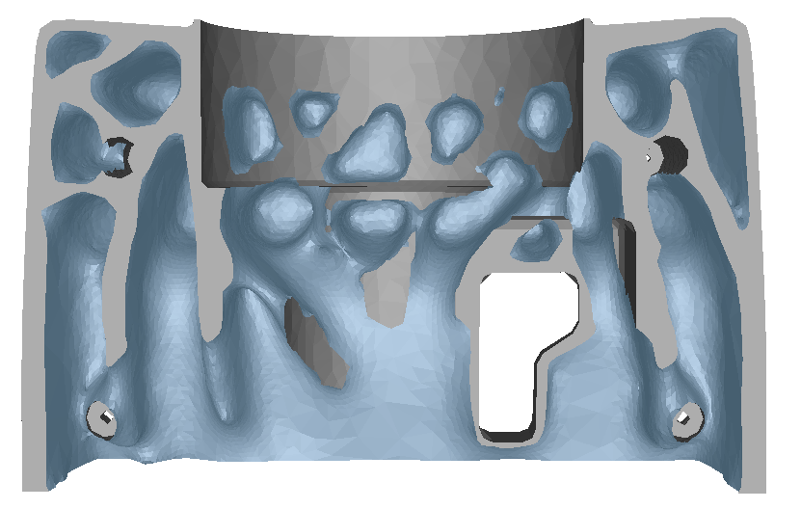
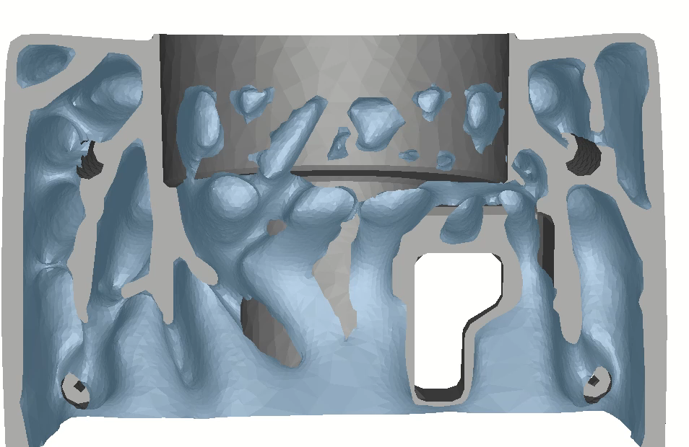


STEERING MODEL
Current Tosca
Cuboid centroids
Using volume fraction
Optimization with local volume ≤ 33%

Slide 20

CAR DOOR MODEL (≈500k elements)
FE model and optimization inputs
Cast direction
Optimization inputs
Objective : minimize compliance
Constraint : local volume ≤ 40%
Midplane : full design height
Design space : interior body below window
Midplane - full design height
top
L_{min},L_{max}
= 1
Boundary conditions → pin supported at door hinges
Loading conditions → vertical force on door handle
bottom
C_{min},C_{max}
= 0

Slide 21









CAR DOOR MODEL
Current Tosca
Cuboid centroids
Using volume fraction
Relative vol : 53.58%
Relative vol : 53.26%
Relative vol : 52.88%
Optimization with local volume ≤ 40%

Slide 22
COMPARISON OF RESULTS
Comparing quantities | Current Tosca | Cuboid centroids | Volume fraction
Low compliance value | ++ | ++ | +
Density plot distribution | ‒ | ‒ | +
Tosca Smooth | ‒ | ‒ | ++
Runtime performance | ‒ / + depending on fine/coarse mesh | ++ | ‒ / + depending on fine/coarse mesh
‒
Impact
+
Benefit
++
Optimal performance

Slide 23
CONCLUSION AND FUTURE WORK

Slide 24
CONCLUSION AND FUTURE WORK
CONCLUSION
Review and understand the current implementation.
Improve the existing code
Verified each functionality with appropriate unit tests.
Validated the implementation with industrial models.
- Modularized the existing code before new implementation.
Cuboid centroids
Volume fraction
- Compared the results qualitatively.
- Evaluated the runtime performance of new implementations.

Slide 25
CONCLUSION AND FUTURE WORK
FUTURE WORK
Parallelization for volume fraction calculation – to increase the runtime performance
Extension of algorithms to use different grids, e.g, a 2d tria grid (to capture intricacies)
Parting midplane :
Elements are identified above and below midplane as positive and negative heights of their centroids.
A single cuboid pole is formed and then split to two domains (above and below midplane)
Bounds for parameter C will be zero ( C_{min} = C_{max} = 0 )
+ve heights
1
3
...
A₁, L₁
Cast direction
Midplane
-ve heights
A₂, L₂
2
4
...
Design
domain
Pole split to two

Slide 26
Thank you for your attention

